Slide 1
INFORMATION SYSTEMS SECURITY, CONTROL AND AUDIT
Information Systems Security
RISK MANAGEMENT, RESPONSE AND RECOVERY
Week 8

Slide 2
Learning Objectives
Upon completion of this chapter, you should be able to:
  Define risk management and its role in the organization
  Begin using risk management techniques to identify and prioritize risk factors for information assets
  Assess risk based on the likelihood of adverse events and the effects on information assets when events occur
  Begin to document the results of risk identification
Notes:
Learning Objectives
Upon completion of this chapter you should be able to:
Recognize the importance of information technology and understand who is responsible for protecting an organization’s information assets
Know and understand the definition and key characteristics of information security
Know and understand the definition and key characteristics of leadership and management
Recognize the characteristics that differentiate information security management from general management

Slide 3
Introduction
Information security departments are created primarily to manage IT risk
Managing risk is one of the key responsibilities of every manager within the organization
In any well-developed risk management program, two formal processes are at work:
  Risk identification and assessment
  Risk control
Notes:
Introduction
Information security departments are created primarily to manage IT risk.
Managing risk is one of the key responsibilities of every manager within the organization.
In any well-developed risk management program, two formal processes are at work:
risk identification and assessment
risk control

Slide 4
Risk Management
If you know the enemy and know yourself, you need not fear the result of a hundred battles
If you know yourself but not the enemy, for every victory gained you will also suffer a defeat
If you know neither the enemy nor yourself, you will succumb in every battle
-- Sun Tzu
Notes:
Risk Management
“If you know the enemy and know yourself, you need not fear the result of a hundred battles.
“If you know yourself but not the enemy, for every victory gained you will also suffer a defeat.
“If you know neither the enemy nor yourself, you will succumb in every battle.”
Sun Tzu

Slide 5
Knowing Ourselves
This means identifying, examining, and understanding the information and how it is processed, stored, and transmitted
Armed with this knowledge, initiate an in-depth risk management program
Risk management is a process, which means the safeguards and controls that are devised and implemented are not install-and-forget devices
Notes:
Knowing Ourselves
This means identifying, examining and understanding the information and how it is processed, stored, and transmitted.
Armed with this knowledge, they can then initiate an in-depth risk management program.
Risk management is a process, which means the safeguards and controls that are devised and implemented are not install-and-forget devices.

Slide 6
Knowing the Enemy
This means identifying, examining, and understanding the threats facing the organization’s information assets
Managers must be prepared to fully identify those threats that pose risks to the organization and the security of its information assets
Risk management is the process of assessing the risks to an organization’s information and determining how those risks can be controlled or mitigated
Notes:
Knowing the Enemy
This means identifying, examining, and understanding the threats facing the organization’s information assets.
Managers must be prepared to fully identify those threats that pose risks to the organization and the security of its information assets.
Risk management is the process of assessing the risks to an organization’s information and determining how those risks can be controlled or mitigated.

Slide 7
Accountability for Risk Management
All communities of interest must work together
  Evaluating the risk controls
  Determining which control options are cost-effective
  Acquiring or installing the appropriate controls
  Overseeing processes to ensure that the controls remain effective
  Identifying risks
  Assessing risks
  Summarizing the findings
Notes:
Accountability for Risk Management
All communities of interest must work together to:
Evaluating the risk controls
Determining which control options are cost-effective
Acquiring or installing the appropriate controls
Overseeing processes to ensure that the controls remain effective
Identifying risks, which includes:
Inventory information assets
Classifying/organizing assets
Assigning information asset value
Identifying threats to the cataloged assets
Pinpointing vulnerable assets by tying specific threats to specific assets
Assessing risks, which includes:
Determining likelihood of attacks on vulnerable systems by specific threats
Assessing relative risk facing information assets, so risk management and control activities can prioritize
Calculating the risks to which assets are exposed in their current setting
Reviewing controls for identified vulnerabilities and says to control the risks that the assets face
Documenting the findings of risk identification and assessment
Summarizing the findings, which involves stating the conclusions of the analysis stage of risk assessment in preparation for moving into the stage of controlling risk by exploring methods to mitigate risk

Slide 8
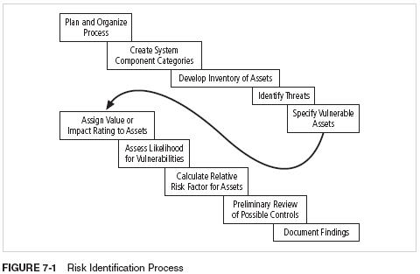
Risk Identification Process

Slide 9
Risk Identification
Risk identification begins with the process of self-examination
Managers identify the organization’s information assets, classify them into useful groups, and prioritize them by their overall importance
Notes:
Risk Identification
Risk identification begins with the process of self-examination.
At this stage, managers identify the organization’s information assets, classify them into useful groups, and prioritize them by their overall importance.

Slide 10
Creating an Inventory of Information Assets
Identify information assets, including people, procedures, data and information, software, hardware, and networking elements
This step should be done without pre-judging the value of each asset; values will be assigned later in the process
Notes:
Creating an Inventory of Information Assets
The risk identification process begins with the identification of information assets, including people, procedures, data and information, software, hardware, and networking elements.
This step should be done without pre-judging the value of each asset; values will be assigned later in the process.

Slide 11
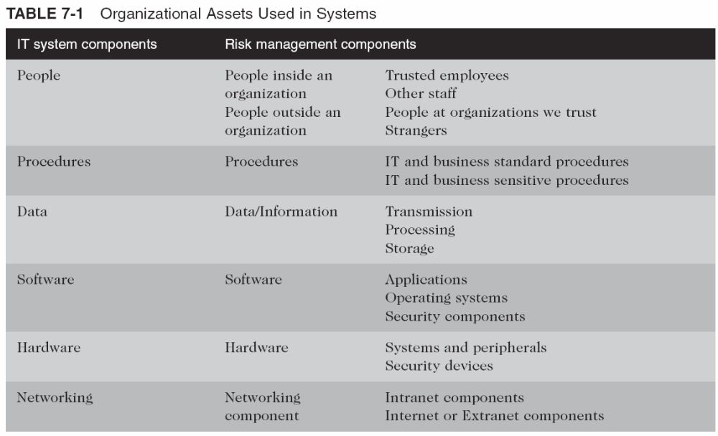






Organizational Assets Used in Systems

Slide 12
Identifying Hardware, Software, and Network Assets
Whether automated or manual, the inventory process requires a certain amount of planning
Determine which attributes of each of these information assets should be tracked
That will depend on the needs of the organization and its risk management efforts
Notes:
Identifying Hardware, Software, and Network Assets
Whether automated or manual, the inventory process requires a certain amount of planning.
Most importantly, you must determine which attributes of each of these information assets should be tracked.
That determination will depend on the needs of the organization and its risk management efforts, as well as the preferences and needs of the information security and information technology communities.

Slide 13

Attributes for Assets
When deciding which attributes to track for each information asset, consider the following list of potential attributes:
  Name
  IP address
  MAC address
  Asset type
  Serial number
  Manufacturer name
  Manufacturer’s model or part number
  Software version, update revision, or FCO number
  Physical location
  Logical location
  Controlling entity
Notes:
Attributes for Hardware Assets
When deciding which attributes to track for each information asset, consider the following list of potential attributes:
Name:
IP address:
MAC address:
Asset type:
DeviceClass = S (server)
DeviceOS = W2K (Windows 2000)
DeviceCapacity = AS (Advanced Server)
Serial number
Manufacturer name:
Manufacturer’s model or part number:
Software version, update revision, or FCO number:
Physical location:
Logical location:
Controlling entity:

Slide 14

Identifying People, Procedures, and
Data Assets
Responsibility for identifying, describing, and evaluating these information assets should be assigned to managers who possess the necessary knowledge, experience, and judgment
As these assets are identified, they should be recorded via a reliable data-handling process like the one used for hardware and software
Notes:
Identifying People, Procedures, and Data Assets
Responsibility for identifying, describing, and evaluating these information assets should be assigned to managers who possess the necessary knowledge, experience, and judgment.
As these assets are identified, they should be recorded via a reliable data-handling process like the one used for hardware and software.

Slide 15
Suggested Attributes for People, Procedures, and Data Assets
People
  Position name/number/ID
  Supervisor name/number/ID
  Security clearance level
  Special skills
Procedures
  Description
  Intended purpose
  Software/hardware/networking elements to which it is tied
  Location where it is stored for reference
  Location where it is stored for update purposes
Notes:
Attributes for People, Procedures, and Data Assets
People
Position name/number/ID
Supervisor name/number/ID
Security clearance level
Special skills
Procedures
Description
Intended purpose
Software/hardware/networking elements to which it is tied
Location where it is stored for reference
Location where it is stored for update purposes
Data
Classification
Owner/creator/manager
Size of data structure
Data structure used
Online or offline
Location
Backup procedures

Slide 16
Suggested Attributes for People, Procedures, and Data Assets (continued)
Data
  Classification
  Owner/creator/manager
  Size of data structure
  Data structure used
  Online or offline
  Location
  Backup procedures

Slide 17
Classifying and Categorizing Assets
Once the initial inventory is assembled, determine whether its asset categories are meaningful
Inventory should also reflect sensitivity and security priority assigned to each information asset
A classification scheme categorizes these information assets based on their sensitivity and security needs
Notes:
Classifying and Categorizing Assets
Once the initial inventory is assembled, you must determine whether its asset categories are meaningful to the organization’s risk management program.
The inventory should also reflect the sensitivity and security priority assigned to each information asset.
A classification scheme should be developed that categorizes these information assets based on their sensitivity and security needs, i.e. confidential, internal, and public.
Each of these classification categories designates the level of protection needed for a particular information asset.
Some asset types, such as personnel, may require an alternative classification scheme that would identify the information security processes used by the asset type.
Classification categories must be comprehensive and mutually exclusive.

Slide 18
Classifying and Categorizing Assets (continued)
Each of these categories designates the level of protection needed for a particular information asset
Some asset types, such as personnel, may require an alternative classification scheme that would identify the clearance needed to use the asset type
Classification categories must be comprehensive and mutually exclusive

Slide 19
Assessing Values for Information Assets
As each information asset is identified, categorized, and classified, assign a relative value
Relative values are comparative judgments made to ensure that the most valuable information assets are given the highest priority, for example:
  Which information asset is the most critical to the success of the organization?
  Which information asset generates the most revenue?
  Which information asset generates the highest profitability?
  Which information asset is the most expensive to replace?
  Which information asset is the most expensive to protect?
  Which information asset’s loss or compromise would be the most embarrassing or cause the greatest liability?
Notes:
Assessing Values for Information Assets
As each information asset is identified, categorized, and classified, a relative value must also be assigned to it.
Relative values are comparative judgments made to ensure that the most valuable information assets are given the highest priority when managing risk.
Which information asset is the most critical to the success of the organization?
Which information asset generates the most revenue?
Which information asset generates the highest profitability?
Which information asset is the most expensive to replace?
Which information asset is the most expensive to protect?
Which information asset’s loss or compromise would be the most embarrassing or cause the greatest liability?

Slide 20
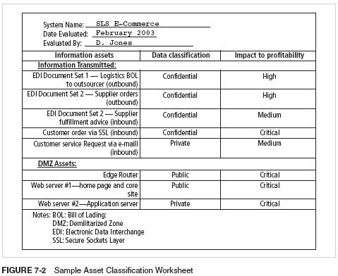
Sample Asset Classification Worksheet

Slide 21
Listing Assets in Order of Importance
The final step in the risk identification process is to list the assets in order of importance
This goal can be achieved by using a weighted factor analysis worksheet
Notes:
Listing Assets in Order of Importance
The final step in the risk identification process is to list the assets in order of importance.
This goal can be achieved by using a weighted factor analysis worksheet.

Slide 22
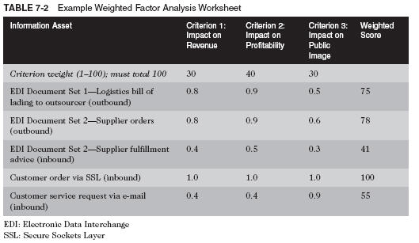
Weighted Factor Analysis Worksheet

Slide 23
Data Classification Model
Data owners must classify the information assets for which they are responsible and review the classifications periodically
Example
  Public
  For official use only
  Sensitive
  Classified
Notes:
Data Classification Model
Corporate and military organizations use a variety of classification schemes.
Data owners must classify the information assets for which they are responsible.
Data owners must review these classifications periodically to ensure that the data are still classified correctly and the access controls are in place.
For Example:
Public:
For official use only:
Sensitive:
Classified:
As you might expect, the U.S. military classification scheme relies on a more complex categorization system than the schemes of most corporations.
For most information, the U.S. military uses a five-level classification scheme as defined in Executive Order 12958:
Unclassified Data:
Sensitive But Unclassified (SBU) Data:
Confidential Data:
Secret Data:
Top Secret Data:

Slide 24
Data Classification Model (continued)
The U.S. military classification scheme relies on a more complex five-level classification scheme as defined in Executive Order 12958
  Unclassified data
  Sensitive but unclassified (SBU) data
  Confidential data
  Secret data
  Top Secret data

Slide 25

Security Clearances
In a security clearance structure, each user of an information asset is assigned an authorization level that indicates the level of information classification they may access
Most organizations have developed roles and corresponding security clearances, so individuals are assigned into groups that correlate with the classifications of the information assets they need for their work
In the need-to-know principle, regardless of one’s security clearance, an individual is not allowed to view data simply because it falls within that individual’s level of clearance

Slide 26
Management of
Classified Information Assets
Managing an information asset includes considering the storage, distribution, portability, and destruction of that information asset
An information asset that has a classification designation other than unclassified or public must be clearly marked as such and must be available only to authorized individuals
To maintain the confidentiality of classified documents, managers can implement a clean desk policy
When copies of classified information are no longer valuable or too many copies exist, care should be taken to destroy them properly to discourage dumpster diving
Notes:
Management of the Classified Information Asset
Managing an information asset includes considering the storage, distribution, portability, and destruction of that information asset.
An information asset that has a classification designation other than unclassified or public must be clearly marked as such.
Classified documents must be available only to authorized individuals - locking cabinets, safes, etc.
To maintain the confidentiality of classified documents, managers can implement a clean desk policy.
When copies of classified information are no longer valuable or too many copies exist, care should be taken to destroy them properly to discourage dumpster diving.

Slide 27
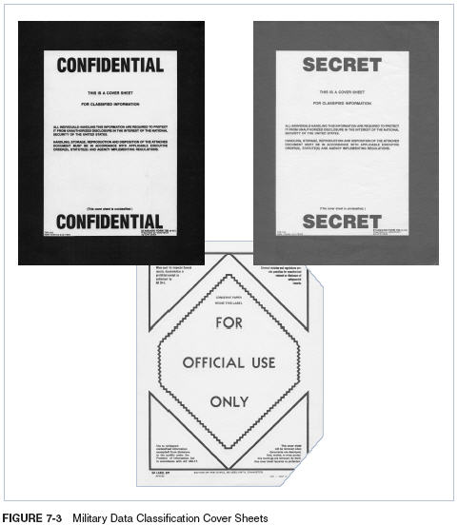
Military Data Classification Cover Sheets

Slide 28
Threat Identification
Any organization typically faces a wide variety of threats
If you assume that every threat can and will attack every information asset, then the project scope becomes too complex
To make the process less unwieldy, each step in the threat identification and vulnerability identification process is managed separately and then coordinated at the end
Notes:
Threat Identification
Any organization typically faces a wide variety of threats.
If you assume that every threat can and will attack every information asset, then the project scope becomes too complex.
To make the process less unwieldy, each step in the threat identification and vulnerability identification processes is managed separately and then coordinated at the end.

Slide 29
Identify and Prioritize
Threats and Threat Agents
Each threat presents a unique challenge to information security and must be handled with specific controls that directly address the particular threat and the threat agent’s attack strategy
Before threats can be assessed in the risk identification process, however, each threat must be further examined to determine its potential to affect the targeted information asset
In general, this process is referred to as a threat assessment
Notes:
Identify And Prioritize Threats and Threat Agents
Each of these threats presents a unique challenge to information security and must be handled with specific controls that directly address the particular threat and the threat agent’s attack strategy.
Before threats can be assessed in the risk identification process, however, each threat must be further examined to determine its potential to affect the targeted information asset.
In general, this process is referred to as a threat assessment.

Slide 30
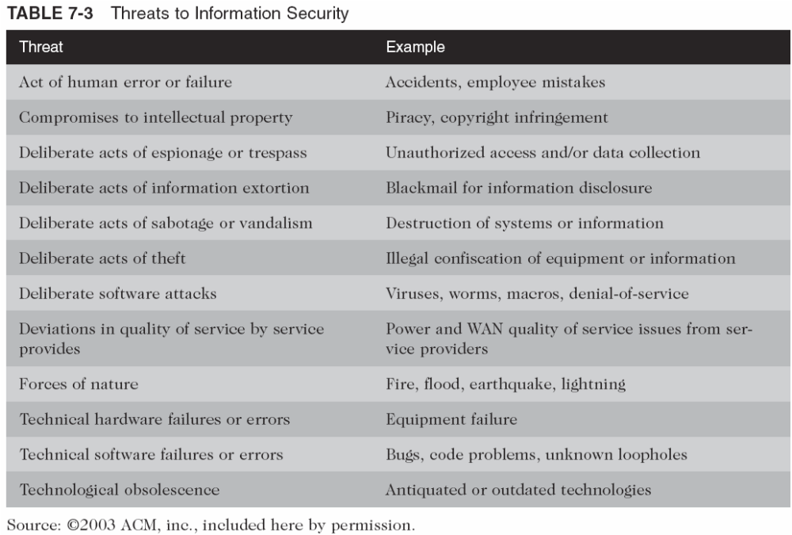
Threats to Information Security

Slide 31
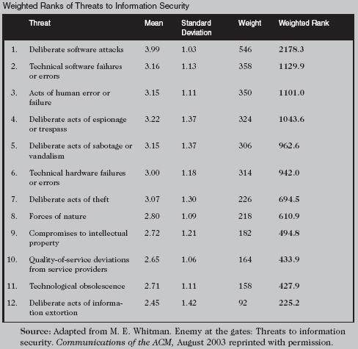
Weighted Ranks of
Threats to Information Security

Slide 32
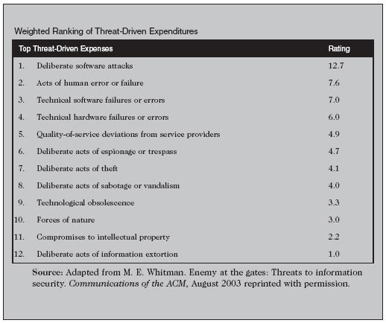
Weighted Ranking of Threat-Driven Expenditures
Notes:
This material can be found in the offline feature within chapter 7.

Slide 33
Vulnerability Assessment
Once you have identified the information assets of the organization and documented some threat assessment criteria, you can begin to review every information asset for each threat
This review leads to the creation of a list of vulnerabilities that remain potential risks to the organization
Vulnerabilities are specific avenues that threat agents can exploit to attack an information asset
At the end of the risk identification process, a list of assets and their vulnerabilities has been developed
This list serves as the starting point for the next step in the risk management process: risk assessment
Notes:
Vulnerability Assessment
Once you have identified the information assets of the organization and documented some threat assessment criteria, you can begin to review every information asset for each threat.
This review leads to the creation of a list of vulnerabilities that remain potential risks to the organization.
Vulnerabilities are specific avenues that threat agents can exploit to attack an information asset.
At the end of the risk identification process, a list of assets and their vulnerabilities has been developed.
This list serves as the starting point for the next step in the risk management process—risk assessment.

Slide 34
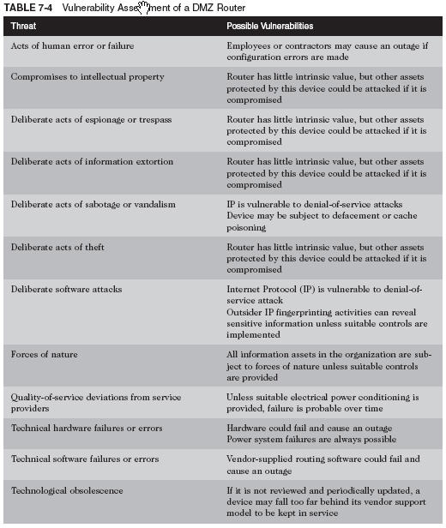
Vulnerability Assessment of a DMZ Router

Slide 35
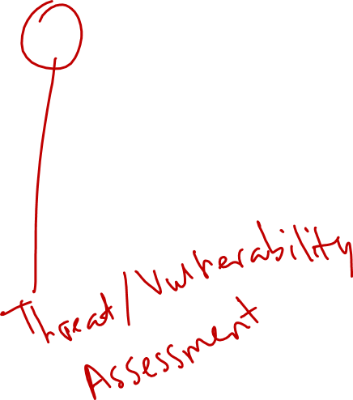
The TVA Worksheet
At the end of the risk identification process, a list of assets and their vulnerabilities has been developed
Another list prioritizes threats facing the organization based on the weighted table discussed earlier
These lists can be combined into a single worksheet

Slide 36
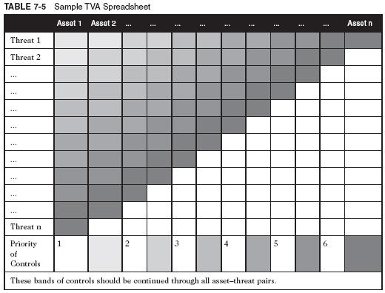
Sample TVA Spreadsheet

Slide 37
Introduction to Risk Assessment
The goal at this point is to create a method to evaluate the relative risk of each listed vulnerability
Notes:
Introduction to Risk Assessment
The goal at this point is to create a method to evaluate the relative risk of each listed vulnerability.

Slide 38
Risk Identification Estimate Factors
Risk is
The likelihood of the occurrence of a vulnerability
Multiplied by
The value of the information asset
Minus
The percentage of risk mitigated by current controls
Plus
The uncertainty of current knowledge of the vulnerability
Notes:
Risk Identification Estimate Factors
Risk is
The likelihood of the occurrence of a vulnerability
Multiplied by
The value of the information asset
Minus
The percentage of risk mitigated by current controls
Plus
The uncertainty of current knowledge of the vulnerability

Slide 39
Likelihood
Likelihood is the overall rating—often a numerical value on a defined scale (such as 0.1 – 1.0)—of the probability that a specific vulnerability will be exploited
Using the information documented during the risk identification process, you can assign weighted scores based on the value of each information asset, i.e. 1-100, low-med-high, etc.
Notes:
Likelihood
Likelihood is the overall rating—a numerical value on a defined scale (.1 – 1.0)—of the probability that a specific vulnerability will be exploited.
Using the information documented during the risk identification process, you can assign weighted scores based on the value of each information asset, i.e. 1-100, low-med-high, etc.

Slide 40
Assessing Potential Loss
To be effective, the likelihood values must be assigned by asking:
  Which threats present a danger to this organization’s assets in the given environment?
  Which threats represent the most danger to the organization’s information?
  How much would it cost to recover from a successful attack?
  Which threats would require the greatest expenditure to prevent?
  Which of the aforementioned questions is the most important to the protection of information from threats within this organization?
Notes:
Assessing Potential Loss
To be effective, the values must be assigned by asking:
Which threats present a danger to this organization’s assets in the given environment?
Which threats represent the most danger to the organization’s information?
How much would it cost to recover from a successful attack?
Which threats would require the greatest expenditure to prevent?
Which of the aforementioned questions is the most important to the protection of information from threats within this organization?

Slide 41
Percentage of Risk
Mitigated by Current Controls
If a vulnerability is fully managed by an existing control, it can be set aside
If it is partially controlled, estimate what percentage of the vulnerability has been controlled
Notes:
Percentage of Risk Mitigated by Current Controls
If a vulnerability is fully managed by an existing control, it can be set aside.
If it is partially controlled, estimate what percentage of the vulnerability has been controlled.

Slide 42
Uncertainty
It is not possible to know everything about every vulnerability
The degree to which a current control can reduce risk is also subject to estimation error
Uncertainty is an estimate made by the manager using judgment and experience
Notes:
Uncertainty
It is not possible to know everything about every vulnerability.
The degree to which a current control can reduce risk is also subject to estimation error. A factor that accounts for uncertainty must always be added to the equations; it consists of an estimate made by the manager using good judgment and experience.

Slide 43
Risk Determination Example
Asset A has a value of 50 and one vulnerability, which has a likelihood of 1.0 with no current controls. Your assumptions and data are 90% accurate.
Asset B has a value of 100 and has two vulnerabilities: vulnerability #2 has a likelihood of 0.5 with a current control that addresses 50% of its risk; vulnerability # 3 has a likelihood of 0.1 with no current controls. Your assumptions and data are 80% accurate.
Notes:
Risk Determination Example
Asset A has a value of 50 and has one vulnerability, which has a likelihood of 1.0 with no current controls. Your assumptions/data are 90% accurate.
Asset B has a value of 100 and has two vulnerabilities: Vul #2 has a likelihood of 0.5 with a current control that addresses 50% of its risk; vul # 3 has a likelihood of 0.1 with no current controls. Your assumptions and data are 80% accurate.
The resulting ranked list of risk ratings for the three vulnerabilities is as follows:
Asset A: Vulnerability 1 rated as 55 = (50 × 1.0) – 0% + 10%.
Asset B: Vulnerability 2 rated as 35 = (100 × 0.5) – 50% + 20%.
Asset B: Vulnerability 3 rated as 12 = (100 × 0.1) – 0 % + 20%.

Slide 44
Risk Determination Example (continued)
The resulting ranked list of risk ratings for the three vulnerabilities is as follows:
  Asset A: Vulnerability 1 rated as 55 = (50 × 1.0) – 0% + 10%
  Asset B: Vulnerability 2 rated as 35 = (100 × 0.5) – 50% + 20%
  Asset B: Vulnerability 3 rated as 12 = (100 × 0.1) – 0 % + 20%

Slide 45
Identify Possible Controls
For each threat and its associated vulnerabilities that have residual risk, create a preliminary list of control ideas
Three general categories of controls exist:
  Policies
  Programs
  Technical controls
Notes:
Identify Possible Controls
For each threat and its associated vulnerabilities that have residual risk, create a preliminary list of control ideas.
Three general categories of controls exist: policies, programs, and technical controls.

Slide 46
Access Controls
Access controls specifically address admission of a user into a trusted area of the organization
These areas can include information systems, physically restricted areas such as computer rooms, and even the organization in its entirety
Access controls usually consist of a combination of policies, programs, and technologies
Notes:
Access Controls
Access controls specifically address admission of a user into a trusted area of the organization.
These areas can include information systems, physically restricted areas such as computer rooms, and even the organization in its entirety.
Access controls usually consist of a combination of policies, programs, and technologies.

Slide 47
Types of Access Controls
Mandatory Access Controls (MACs) are required and are structured and coordinated with a data classification scheme
When MACs are implemented, users and data owners have limited control over their access to information resources
MACs use a data classification scheme that rates each collection of information
Notes:
Types of Access Controls
Mandatory Access Controls (MACs) are required and are structured and coordinated with a data classification scheme.
When MACs are implemented, users and data owners have limited control over their access to information resources.
MACs use a data classification scheme that rates each collection of information.

Slide 48

Types of Access Controls (continued)
In lattice-based access controls, users are assigned a matrix of authorizations for particular areas of access
The matrix contains subjects and objects, and the boundaries associated with each subject/object pair are clearly demarcated
With this type of control, the column of attributes associated with a particular object is called an access control list (ACL)
The row of attributes associated with a particular subject is a capabilities table

Slide 49
Types of Access Controls (continued)
Nondiscretionary controls are determined by a central authority in the organization and can be based on roles—called role-based controls—or on a specified set of tasks—called task-based controls
  Task-based controls can, in turn, be based on lists maintained on subjects or objects
  Role-based controls are tied to the role that a particular user performs in an organization, whereas task-based controls are tied to a particular assignment or responsibility
Notes:
Types of Access Controls Continued
Nondiscretionary controls are determined by a central authority in the organization and can be based on roles—called role-based controls—or on a specified set of tasks—called task-based controls.
Task-based controls can, in turn, be based on lists maintained on subjects or objects.
Role-based controls are tied to the role that a particular user performs in an organization, whereas task-based controls are tied to a particular assignment or responsibility.

Slide 50
Types of Access Controls (continued)
Discretionary Access Controls (DACs) are implemented at the discretion or option of the data user
The ability to share resources in a peer-to-peer configuration allows users to control and possibly provide access to information or resources at their disposal
The users can allow general, unrestricted access, or they can allow specific individuals or sets of individuals to access these resources
Notes:
Types of Access Controls Continued
Discretionary Access Controls (DACs) are implemented at the discretion or option of the data user.
The ability to share resources in a peer-to-peer configuration allows users to control and possibly provide access to information or resources at their disposal.
The users can allow general, unrestricted access, or they can allow specific individuals or sets of individuals to access these resources.

Slide 51
Documenting the Results of Risk Assessment
The goal of the risk management process so far has been to identify information assets and their vulnerabilities and to rank them according to the need for protection
In preparing this list, a wealth of factual information about the assets and the threats they face is collected
Also, information about the controls that are already in place is collected
The final summarized document is the ranked vulnerability risk worksheet
Notes:
Documenting the Results of Risk Assessment
The goal of the risk management process so far has been to identify information assets and their vulnerabilities and to rank them according to the need for protection.
In preparing this list, a wealth of factual information about the assets and the threats they face is collected.
Also, information about the controls that are already in place is collected.
The final summarized document is the ranked vulnerability risk worksheet.

Slide 52
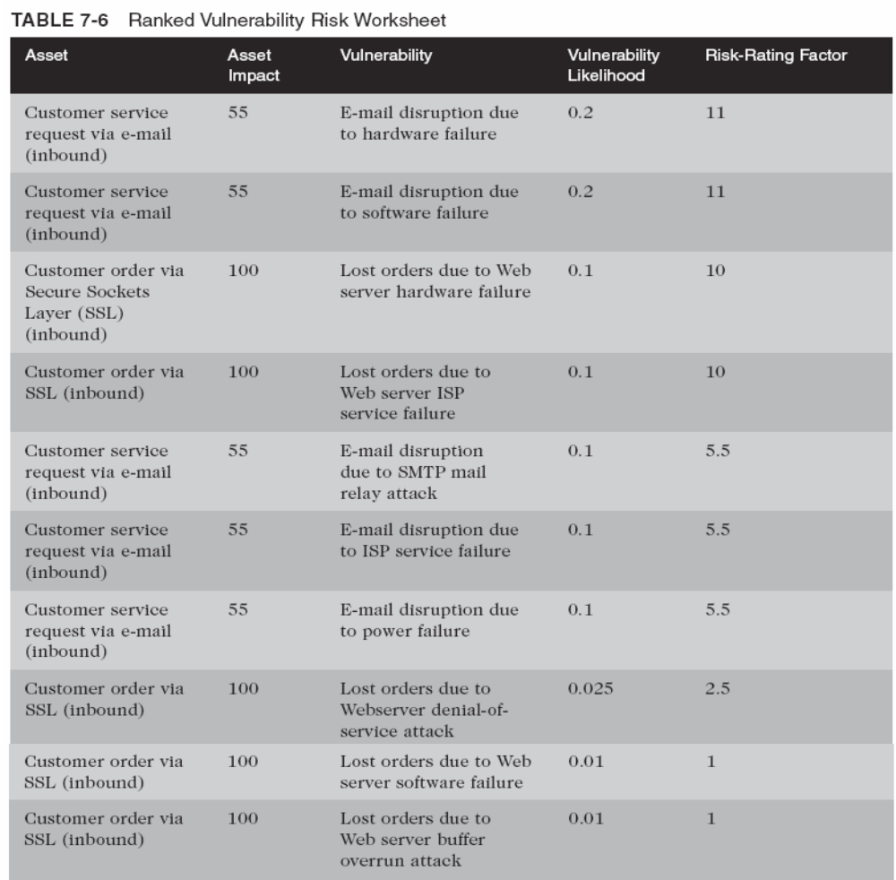
Ranked
Vulnerability
Risk
Worksheet
Management of Information Security, 2nd ed. - Chapter 7
Slide <number>

Slide 53
Documenting the Results of Risk Assessment (continued)
What should the documentation package look like?
What are the deliverables from this stage of the risk management project?
The risk identification process should designate what function the reports serve, who is responsible for preparing them, and who reviews them
Notes:
Documenting the Results of Risk Assessment Continued
What should the documentation package look like?
What are the deliverables from this stage of the risk management project?
The risk identification process should designate what function the reports serve, who is responsible for preparing them, and who reviews them.

Slide 54
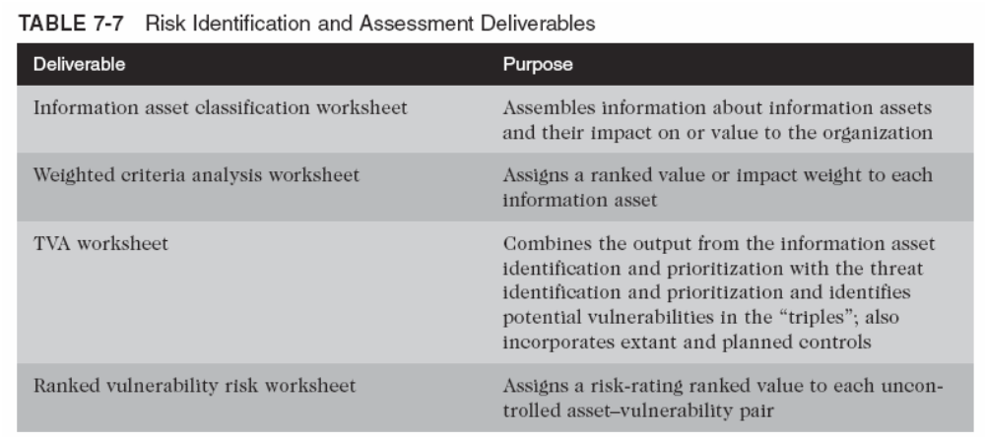
Risk Identification and Assessment Deliverables

Slide 55
Summary
Risk Management
Risk Identification
Risk Assessment
Documenting the Results of Risk Assessment
Notes:
Summary
Risk Management
Risk Identification
Risk Assessment
Documenting the Results of Risk Assessment

